Slide 1
Recent ARC developments in the EMI project
Andrii Salnikov, Ievgen Sliusar
UNG 2012, November 1

Slide 2
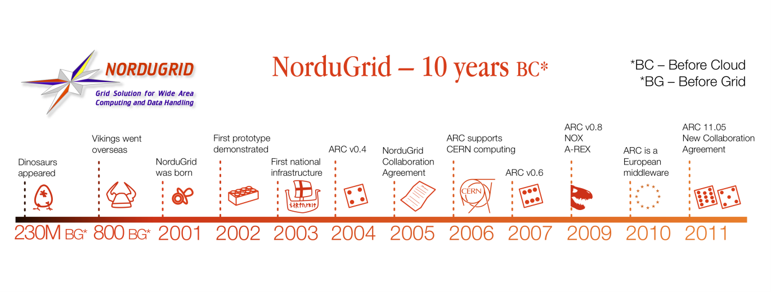

Road behind ARC
UAG
Balázs Kónya, NorduGrid 2012, Uppsala, Sweden
First grid clusters
in Ukraine:
KIPT, BITP, KNU
First grid segment
of NASU

Slide 3





EMI goal
Before EMI
3 years
After EMI
Implemented Agreements
EMI common products
Balázs Kónya, NorduGrid 2012, Uppsala, Sweden
Repositories
Standards,
New technologies,
Users and Infrastructure Requirements

Slide 4
EMI Standards
CE: EMI-ES (CREAM, A-REX, UNICORE/X)
IS: GLUE2 XML and LDAP rendering
II: EMI Registry (EMIR)
SE: SRM v2.2 (dCache, DPM, StoRM)
Accounting: APEL
EMI Clients: ARC Clients
EMI DataLib: GFAL2
EMI Security: VOMS, caNl

Slide 5

A-REX
Job management interfaces:
gridFTP (old one, globus-based, will be dropped)
xBES (OGSA WS-interface, not really used)
EMI-ES
Secure, Robust, Feature-rich CE
Runs on any UNIX/Linux platforms
No impact on other OS components
Support various batch systems
Easily extendable by plugins

Slide 6
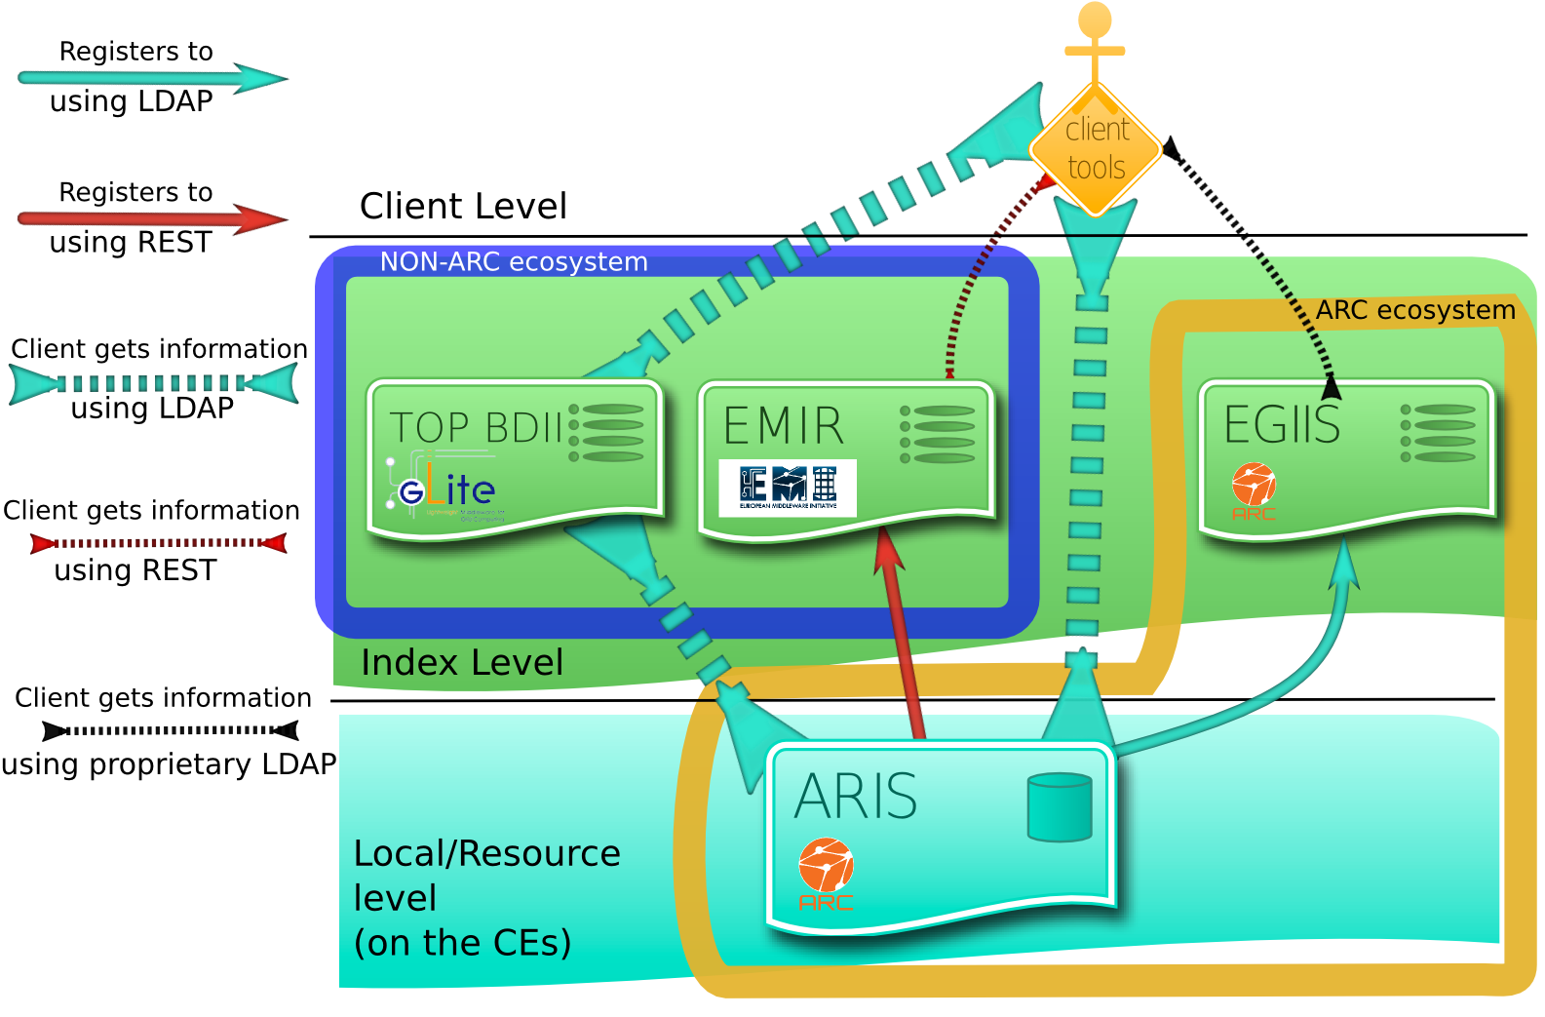
ARIS
Florido Paganelli, NorduGrid 2012, Uppsala, Sweden
LDAP NorduGrid
LDAP Glue1.3
GLUE2

Slide 7
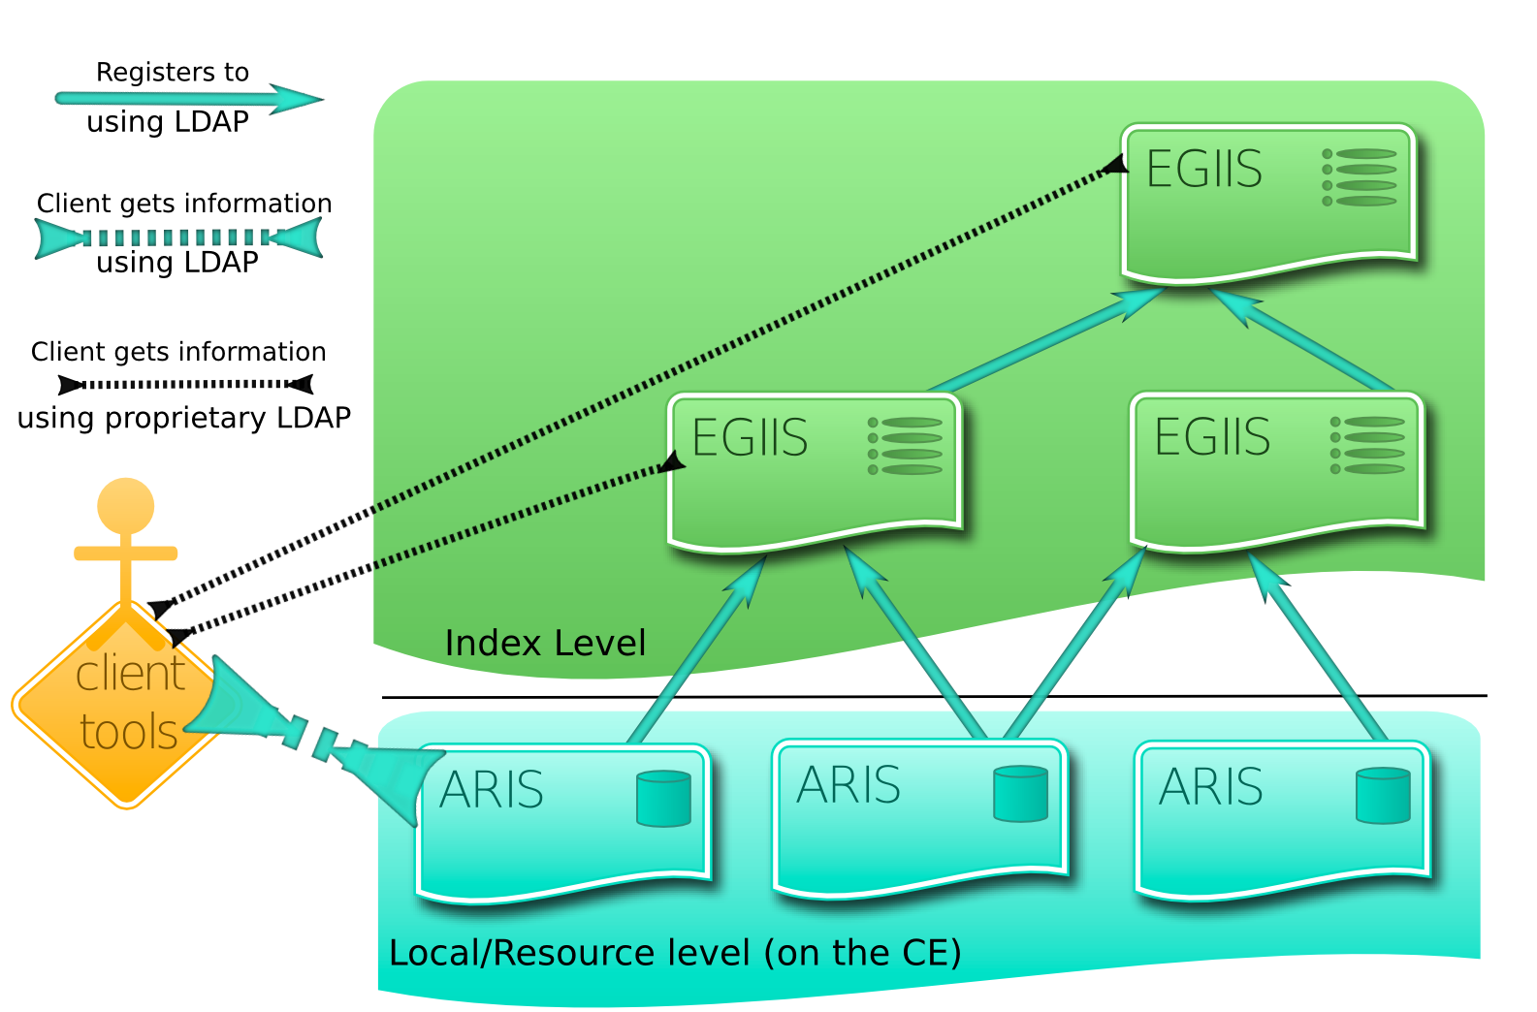
ARC service discovery
NorduGrid LDAP Only
Performance Issues
Florido Paganelli, NorduGrid 2012, Uppsala, Sweden

Slide 8
Other components
SE: ARC withdrawn own SE implementation, but works well with existing ones.
Accounting to APEL: JURA (almost there).
ARC Clients as EMI Clients: fully interoperable with GLUE2 and EMIR. Ongoing performance improvements and more testing.
EMI DataLib: ARC DataLib is able to employ GFAL2 (code is finished), but packaging issues exist.
EMI Security: caNl++ is finished, client-side integration for arcproxy tool only, same problems with packaging.

Slide 9

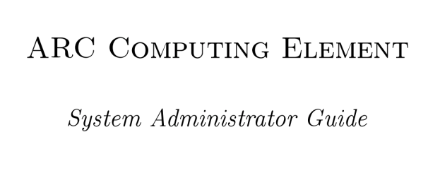
Documentation
Balázs Kónya, NorduGrid 2012, Uppsala, Sweden

Slide 10
UNG ARC Deployment
Total sites in EGIIS: 33
  Sites in giis.grid.org.ua EGIIS: 28
  Sites in lcg.bitp.kiev.ua EGIIS: 20
Sites with GLUE2: 5
Sites with EMI-ES: 4
failed - 3
0.6.1 - 1
0.6.5 - 4
0.8.1 - 1
0.8.1.1 - 1
0.8.3 - 1
0.8.3.1 - 5
1.0.1 - 1
1.1.0 - 4
2.0.0 - 12

Slide 11
Moving the right way ☺
Update to EMI-2 ARC and keep it up to date
Enable GLUE2 and EMI-ES
Read the manual and find advanced configuration use-cases to efficiently utilize cluster resources
EMIR deployment in Ukraine (almost there)
Enable accounting (SGAS and APEL)
Use the latest EMI clients!

Slide 12
Our contribution
ARC components:
nordugridmap
PBS batch system backends
plugins for advanced use-cases
documentation
lots of bug-reports and bug-fixes
Stand-alone solutions:
PHP VOMS-Admin

Slide 13
Questions?

